Slide 1
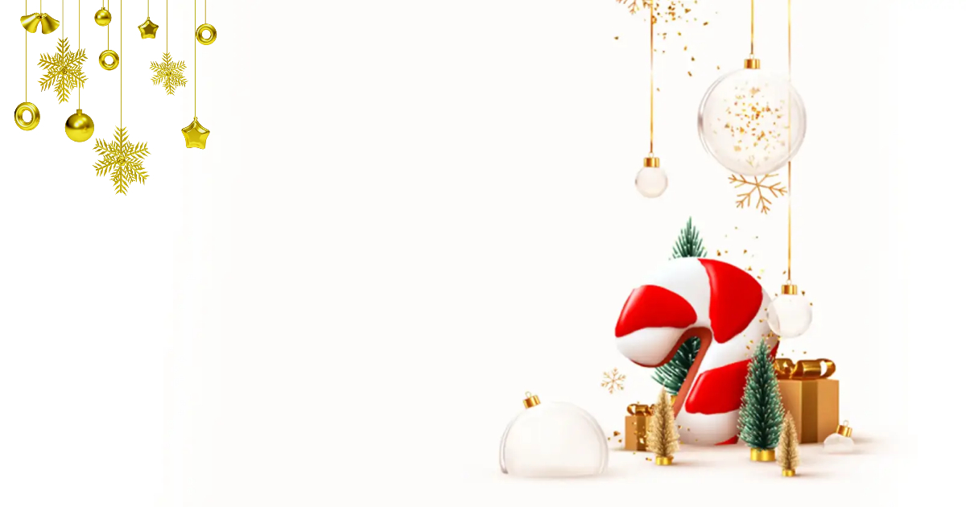
Dear Guest,
It gives us a great pleasure to invite you to the Christmas Gala Dinner in Fun City lobby ground floor, We wish you a nice evening
Serenity Hotels Management
Dear Guest,
It gives us a great pleasure to invite you to the Christmas Gala Dinner in Fun City lobby ground floor, We wish you a nice evening
Serenity Hotels Management
Merry
Christmas
Merry
Christmas

Slide 2
24th December
Christmas
Kids program
24th December
Christmas
Kids program
10.30 Gathering in kids club.
11.00 face painting & funny games.
11.30 Treasure hunt.
12.00 Meeting X-Mass characters.
12.30 Meeting Santa Claus on the beach.
13.00 Lunch break.
15.00 Kids carnival.
20.00 Face painting.
20.30 Mini disco.
10.30 Gathering in kids club.
11.00 face painting & funny games.
11.30 Treasure hunt.
12.00 Meeting X-Mass characters.
12.30 Meeting Santa Claus on the beach.
13.00 Lunch break.
15.00 Kids carnival.
20.00 Face painting.
20.30 Mini disco.
24th December
Christmas Eve
Itinerary
24th December
Christmas Eve
Itinerary
18.00 Gathering at lobby.
18.15 Reception cocktails.
18.30 Seating.
18.45 Dinner buffet & back ground music.
19.30 Instrumental.
21.15 Dance show
18.00 Gathering at lobby.
18.15 Reception cocktails.
18.30 Seating.
18.45 Dinner buffet & back ground music.
19.30 Instrumental.
21.15 Dance show

