Slide 1
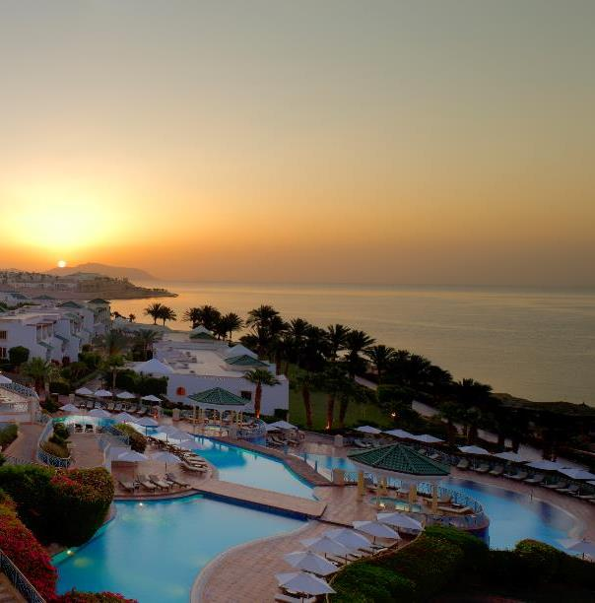
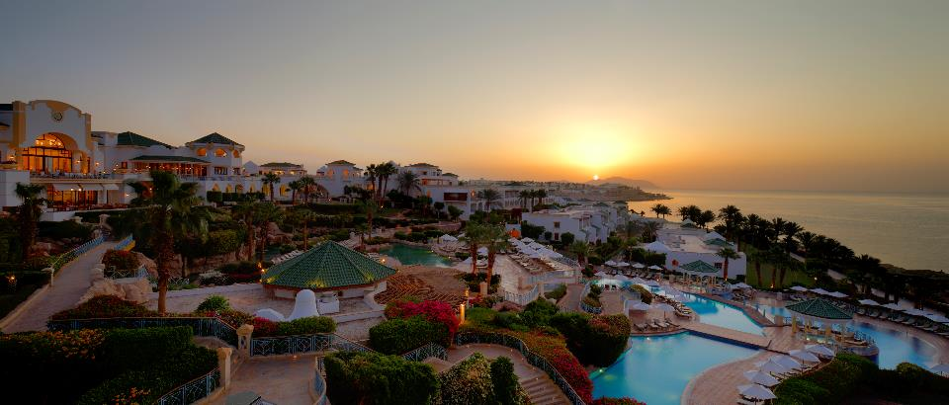
HYATT REGENCY
SHARM EL SHEIKH
A promise of finesse

Slide 2
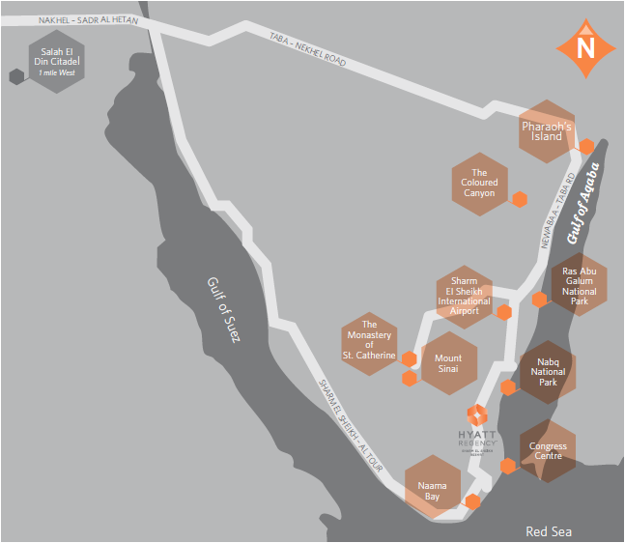
Location
Hyatt Regency Sharm El Sheikh is ideally situated in the Gardens Bay, based on the edge of an aqua oasis overlooking one of the world’s best diving and snorkeling spots, with direct access to the splendid marine life of Sharm El Sheikh boasting one of the most beautiful beaches in Sharm El Sheikh and coupled with a panoramic views of the Sinai mountains.
Only10 minutes by car from Sharm El Sheikh International Airport.
Popular sightseeing & attractions
Saint Catherine Monastery
Moses Mountain
Colored Canyon and Blue Hole
Thistlegorm Wreck ship
Nabq National Park
Ras Abu Ghalum National Park
Ras Mohamed National Park
Tiran Island
Quad Safari
Sharm Grand Casino
Pharoah Island and Salah El Din Citadel
Naama Bay
Soho Square
2

Slide 3
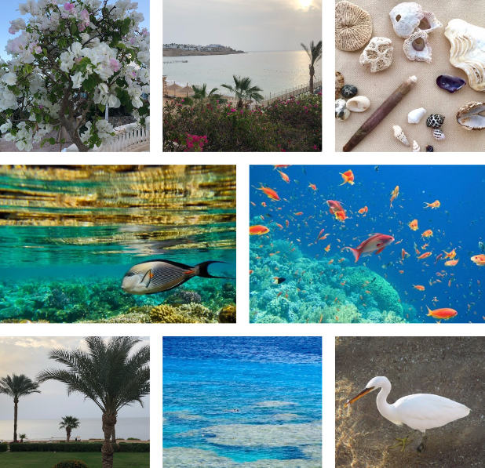
“Look deep into nature, and then you will understand everything better” Albert Einstein

Slide 4
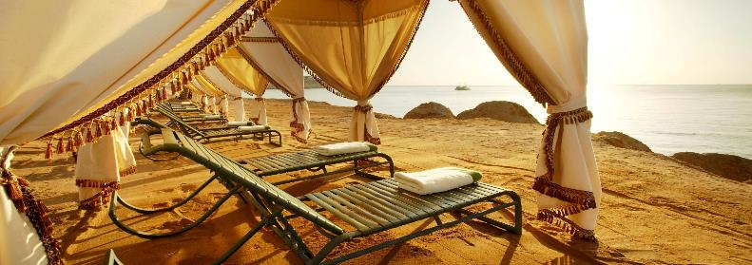
Relax on the pristine golden beach
All you need is vitamin Sea

Slide 5
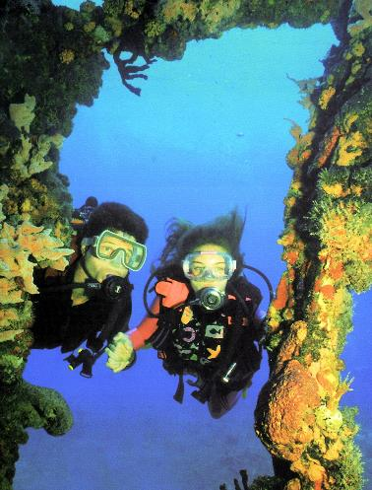
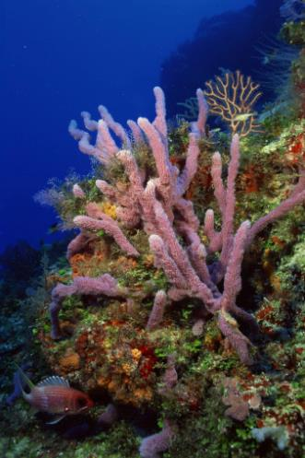
“Go Diving and you will have a few minutes
of peace and quite” Ronnie Lampole

Slide 6
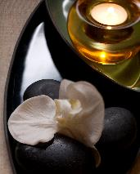
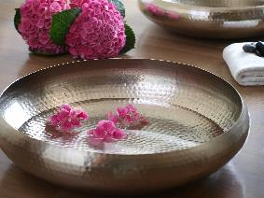
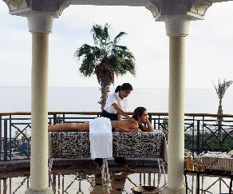
“Health is a state of body, wellness is a state of being”
J. Stanford
6

Slide 7
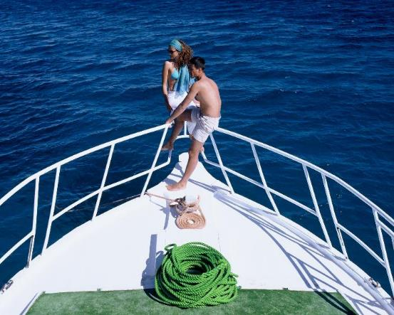
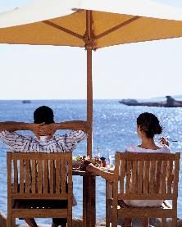
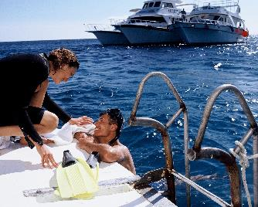
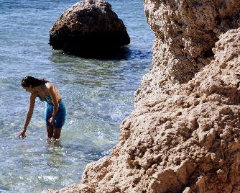
“One touch of nature makes the whole world kin”
William Shakespeare
7

Slide 8
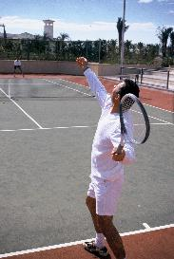
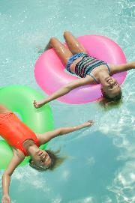
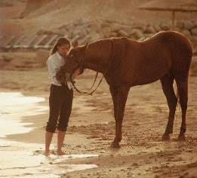
“Even though you're growing up, you should never stop having fun” Nina Dobrev
8

Slide 9
“It’s nice to just embrace the natural beauty within you” Victoria Justice
Welcome to Hyatt Regency Sharm El Sheikh
Your home to indulge in the beauty of nature
A scenic leisure retreat, situated on the golden shore of Gardens Bay with a picturesque landscape of the Red Sea, cascading pools & waterfalls, gardens and lagoon-style swimming pools.
9

Slide 10
Hotel Lobby and Azure Lounge

Slide 11
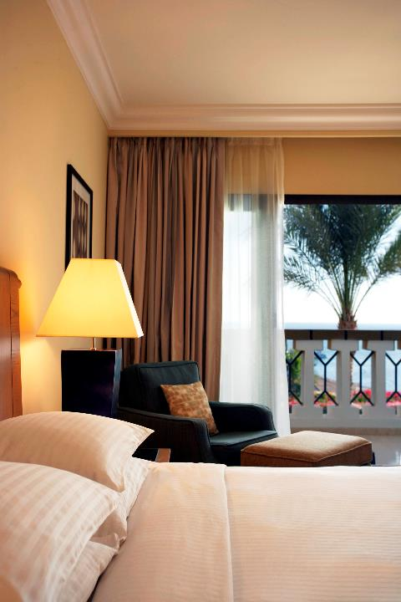
Accommodations
432 rooms including:
282 Sea View Rooms
70 Sea Front Rooms
40 Regency Club rooms
25 Regency Suites
8 Parlor Suites
2 Executive Suites
3 Diplomatic Suites
2 villas
All Accommodations Offer:
All guests rooms and suites overlook the Red Sea
Down Pillows and duvet (non allergic available)
Complimentary WI-Fi
Flat Panel LCD television with wide range of international channels
Direct dial telephone with voice mail
Individual climate control
Full bathroom amenties and hair dryer
100% Egyptian cotton linen and towels
Tea & Coffee making facilities
Minibar and in room personal safe
Iron / ironing board

Slide 12
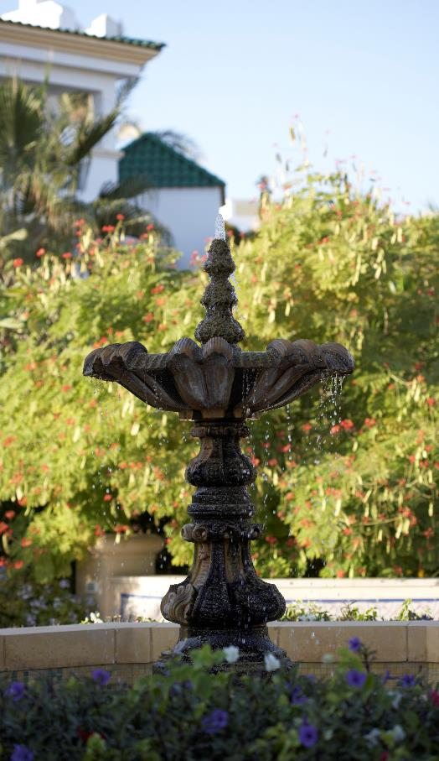
Regency Club, Hyatt’s “hotel within a hotel” concept offers privacy and uncompromising luxury for discriminating guests.
The Regency Club is housed in an elegant villa that has a cosy and very classic feel.
The veranda is the perfect setting from which to enjoy the rosy sunset with a cocktail. Regency Club guests benefit from a private check-in and concierge, as well as daily complimentary Continental breakfast and evening pre-dinner drinks and canapés at the clubhouse.
There is also a boardroom for private meetings.
In terms of aqua amenities, Regency Club guests may enjoy a private beach, two pools and a whirlpool.

Slide 13
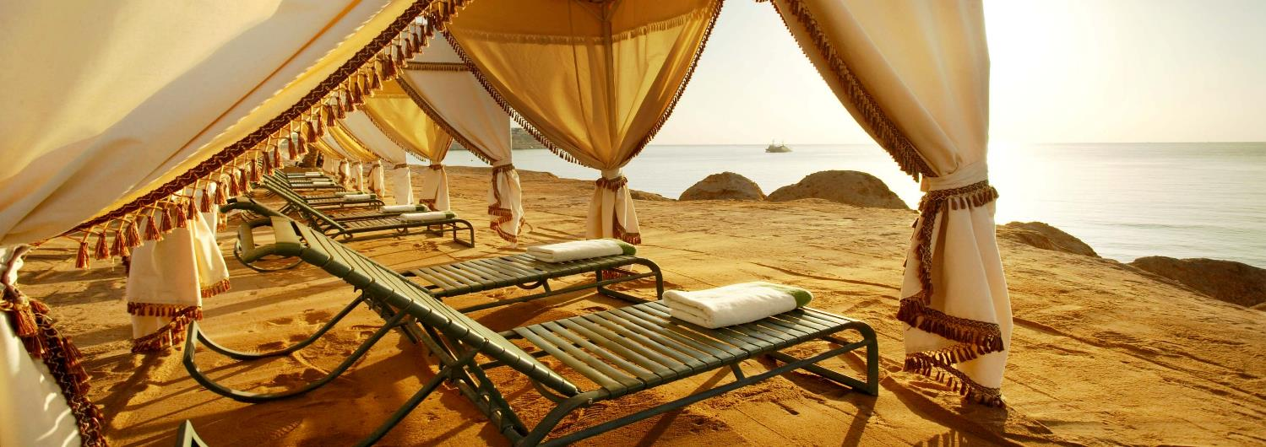
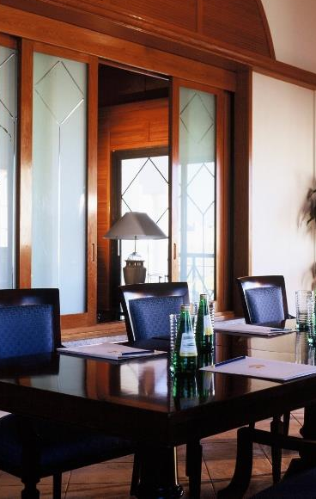
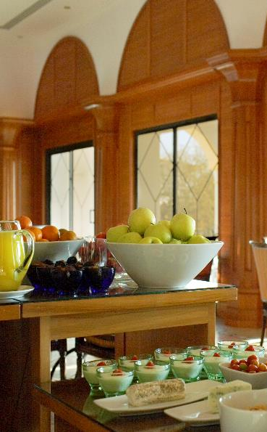
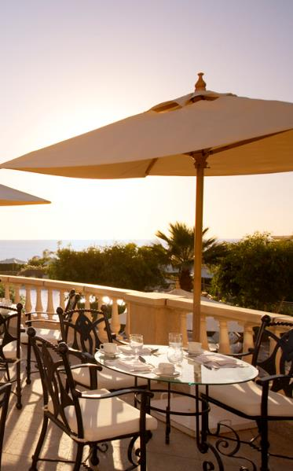
Private Beach
Meeting Room
Breakfast
Terrace
Regency Club Swimming Pool

Slide 14
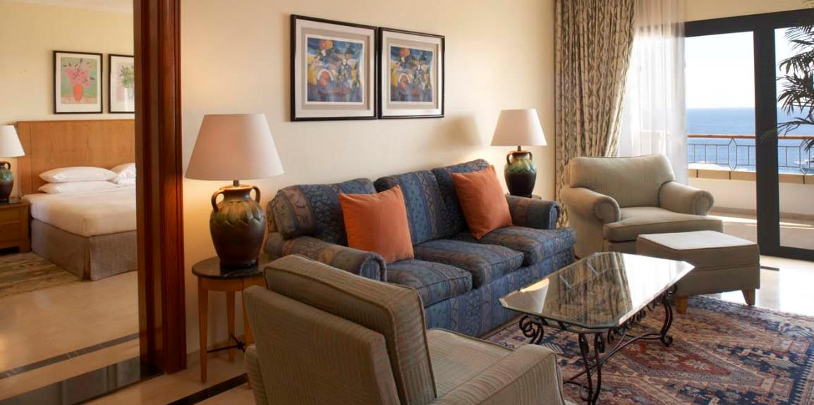
Regency Suite
Experience the luxury of a 76 m² villa suite offering stunning views of the Red Sea from an extended balcony.
Mediterranean-inspired decor features a large living area, two bathrooms, king/twin bedroom and work area with high-speed Internet.

Slide 15
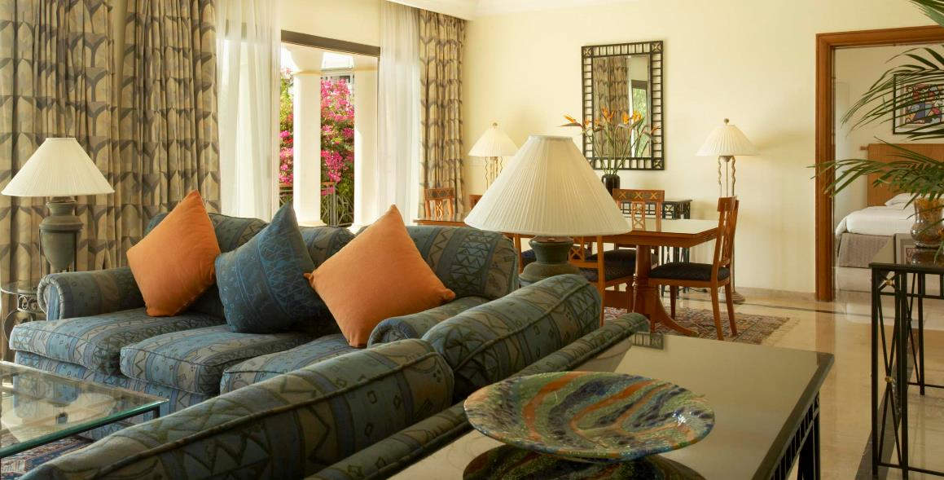
Executive Suite
Experience the luxury of a 124 m² villa suite offering stunning views of the Red Sea from a 26 m² terrace. Mediterranean-inspired decor features a large living area, dining area, two bathrooms, king bedroom and work area with high-speed Internet.

Slide 16
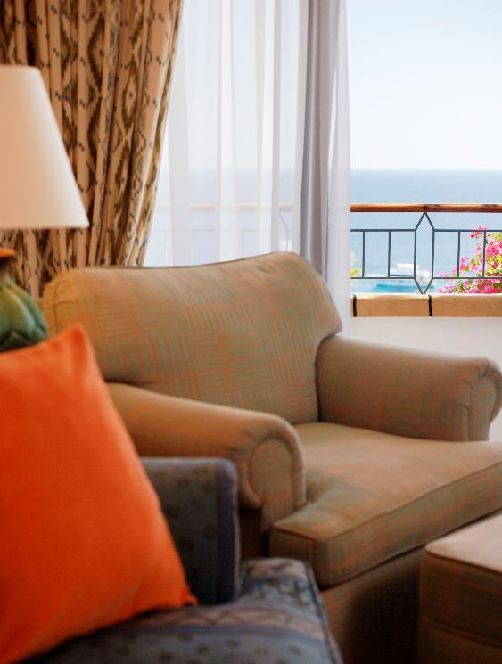
Diplomatic Suite
Experience the luxury of a 164 m² villa suite offering stunning views of the Red sea from a 26 square meters terrace. Mediterranean inspired décor features a large living area, three bathrooms, a kitchenette, two bedrooms and a work area with high speed internet access.

Slide 17
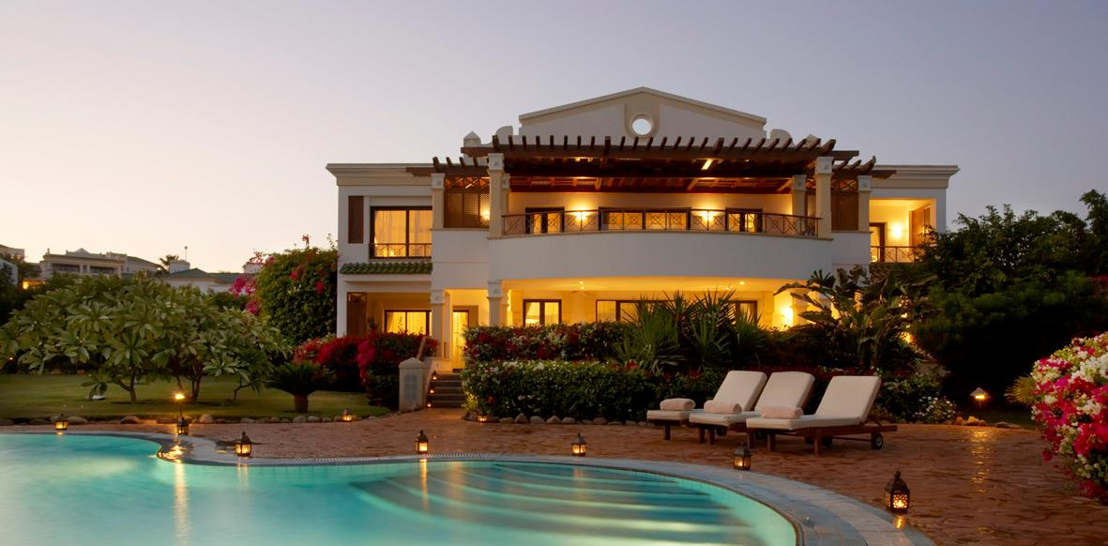
Royal Villa
A spectacular beachfront setting on the Red Sea welcomes you to a 307 m², two level retreat featuring a ground level that opens onto a 114 m² private verandah. Lavish decoration includes an outdoor dining area on the verandah, guest living room, dining room, writing desk and guest toilet, fully equipped kitchen with service door and twin guest room and bathroom, with shower and bath. Upstairs features include a master bedroom covering 54 m² with a king-size bed, living room with writing desk, master bathroom with step-in Jacuzzi, two vanity tables and walk-in wardrobe, guest bedroom of 47 m² and bathroom.

Slide 18
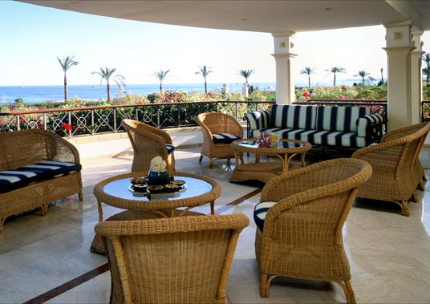
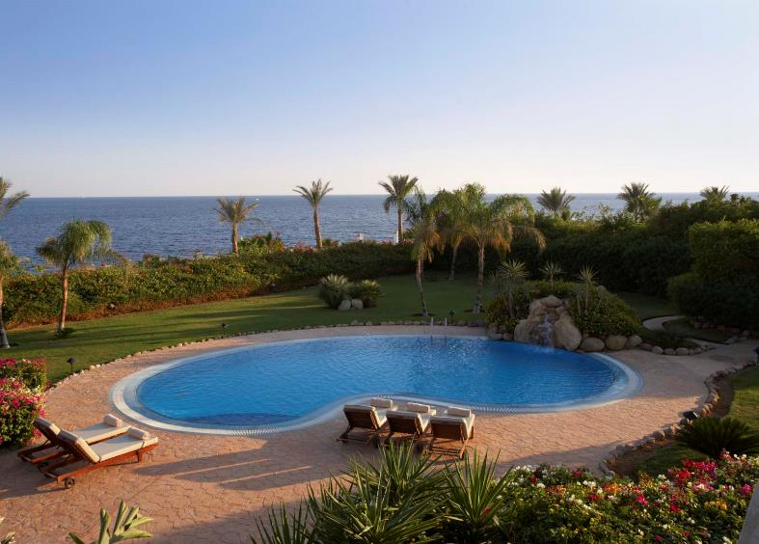
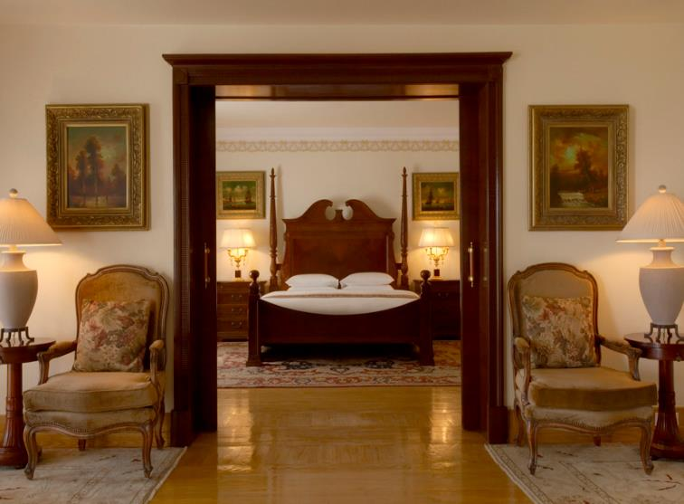
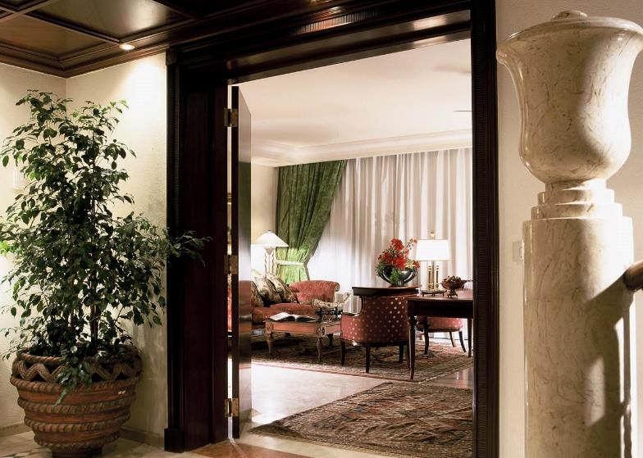
Villa Terrace
Villa Swimming Pool
Villa Bedroom
Villa Living Room

Slide 19
Culinary Experience

Slide 20
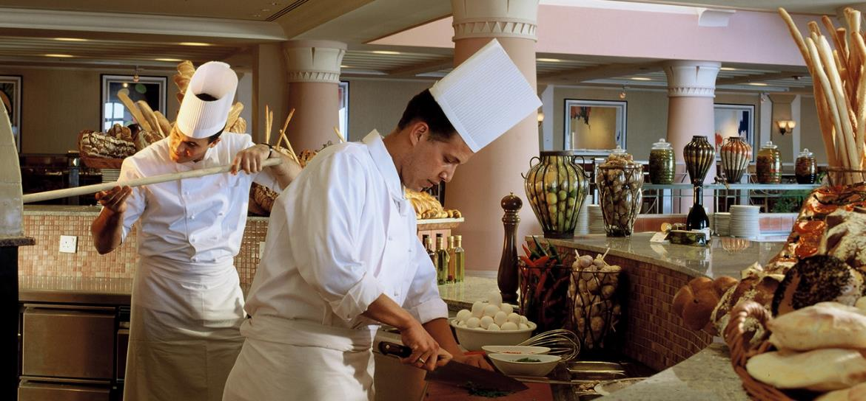
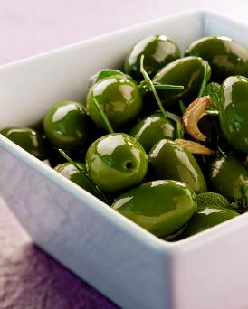
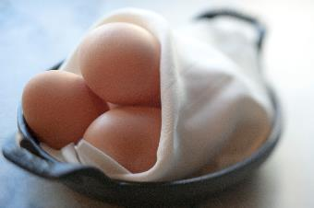
Café Fresco
Breakfast

Slide 21
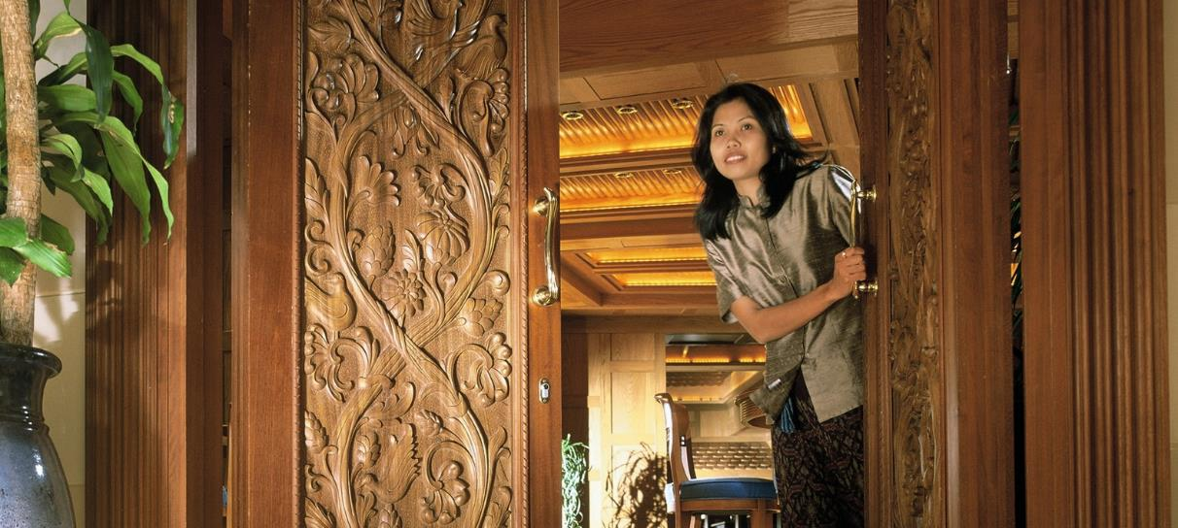
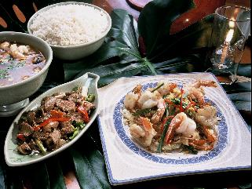
Sala Thai
Eastern style sensuality, modelled on a traditional Thai garden house. Thai chefs carrying out their artistry in a splendid show kitchen. Subtle flavors of ginger, coriander and lemon grass.

Slide 22
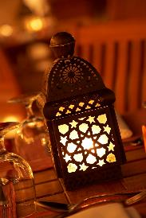
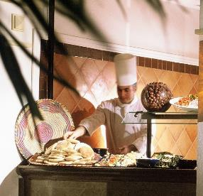
Souk
Inspired by the ancient Market Place With a vibrant entertainment schedule,
Souk offers exciting live cuisine from our six show kitchens featuring Italian, Asian, Oriental and international dishes, as well as a Fish Market and, of course, decadent desserts.

Slide 23
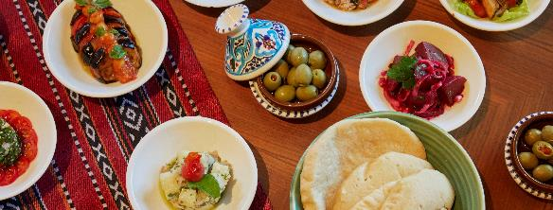
Beach House
Lunch, Snacks & Refreshments

Slide 24
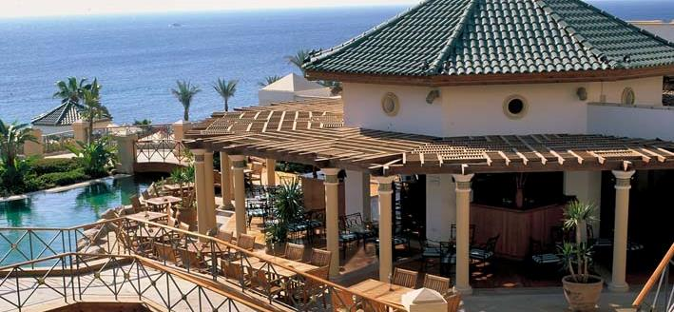
Cascades
Lunch, Snacks & Refreshments

Slide 25
Meetings & Events

Slide 26
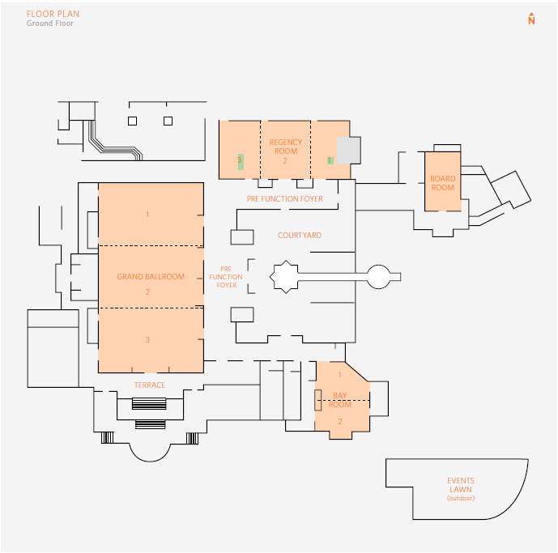

Slide 27
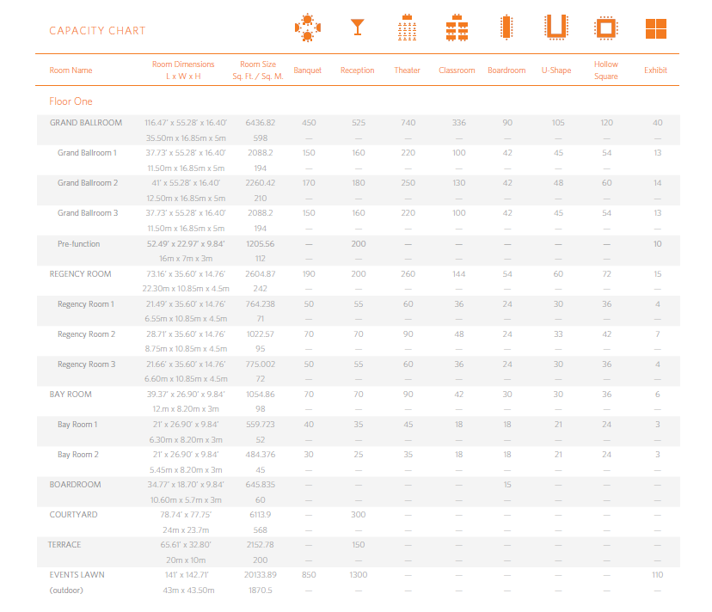

Slide 28
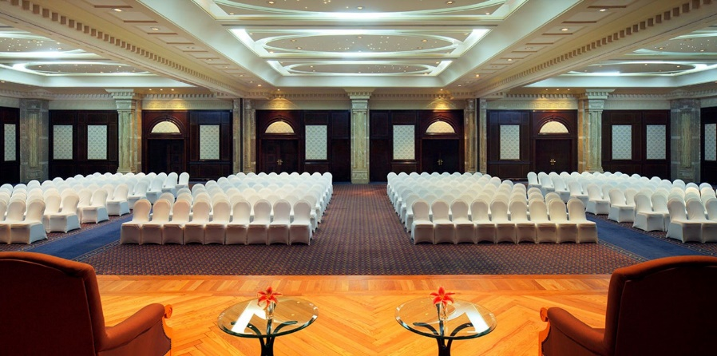

Slide 29
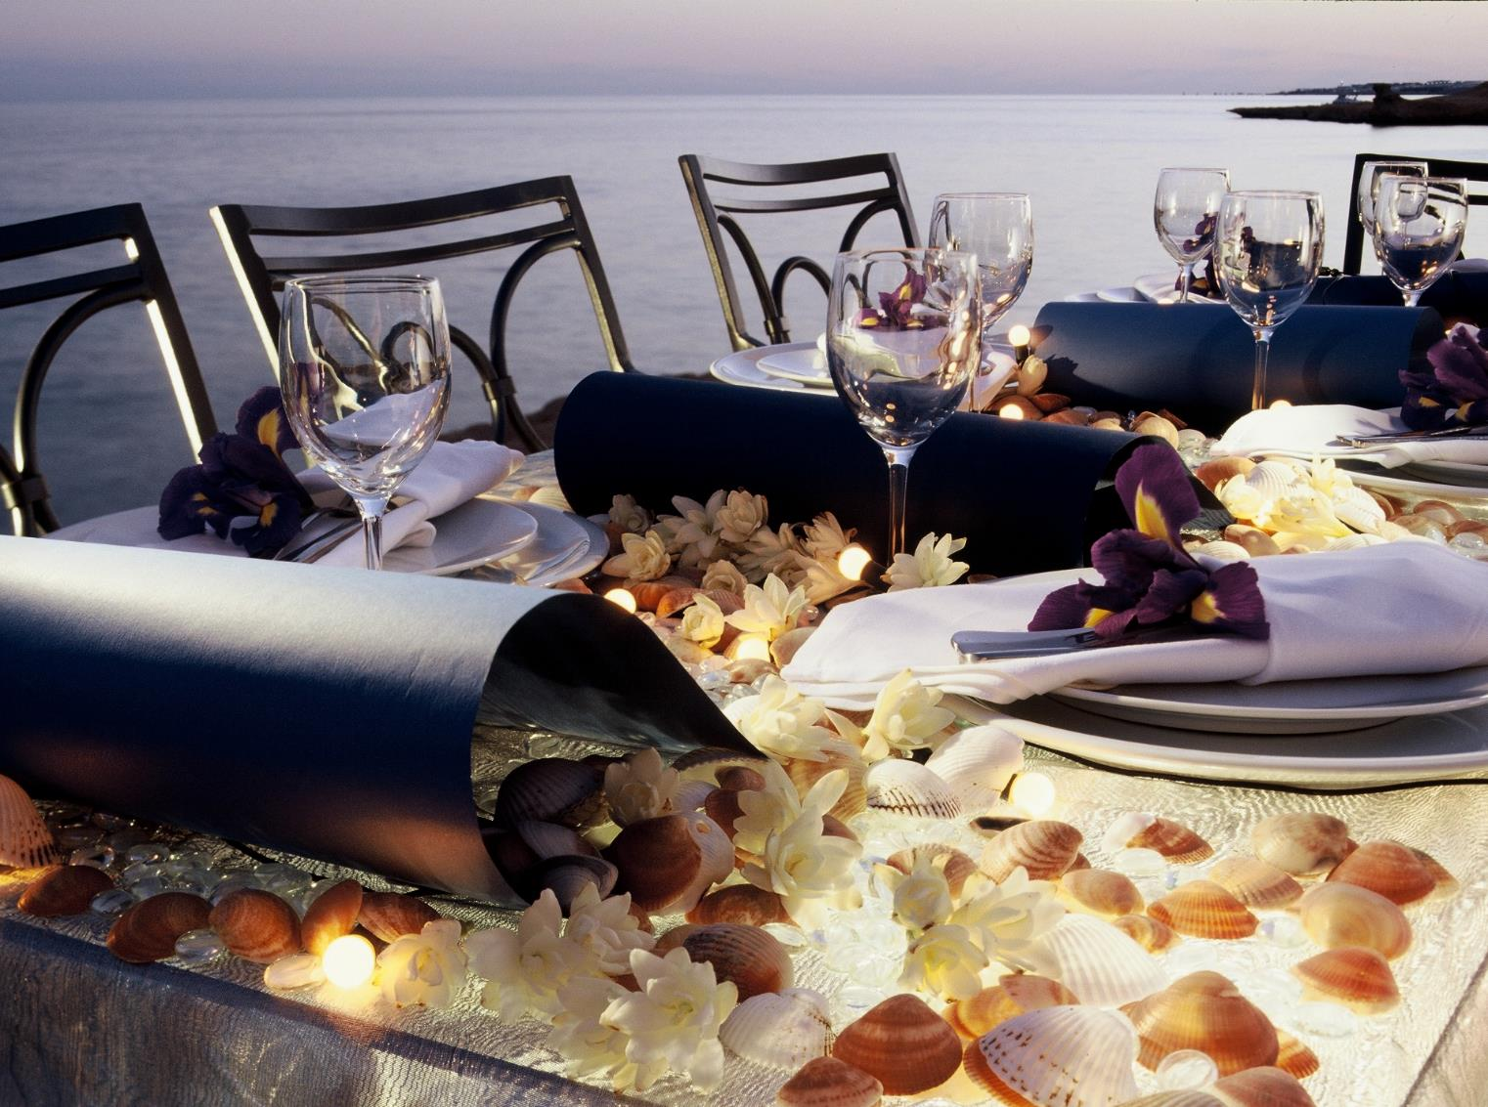

Slide 30
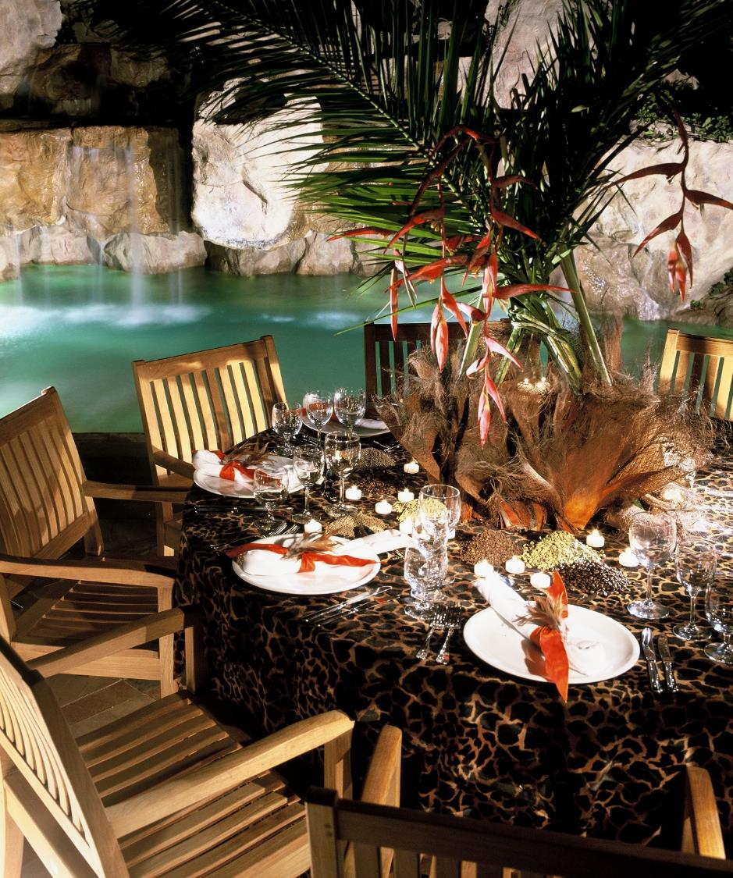
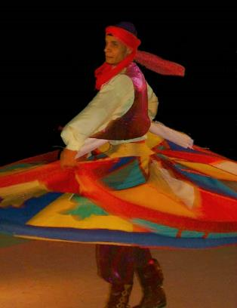
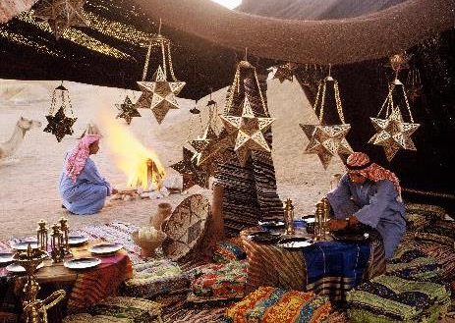

Slide 31
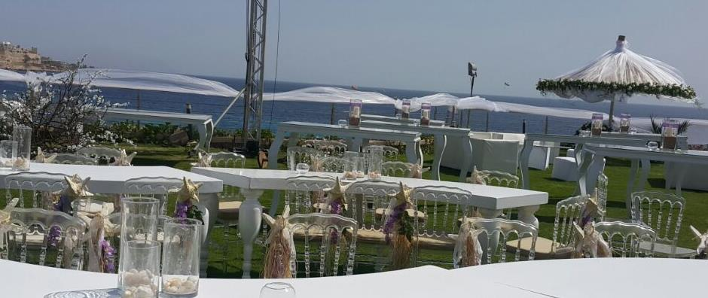
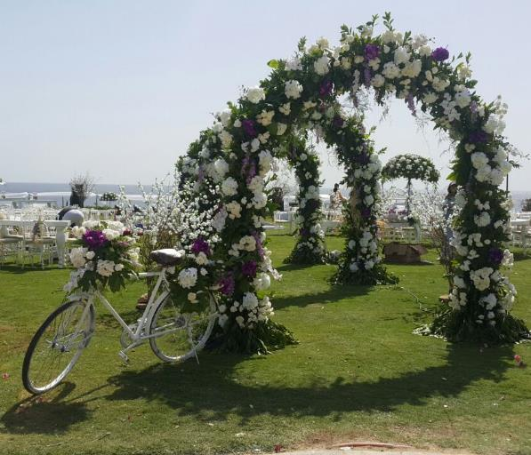
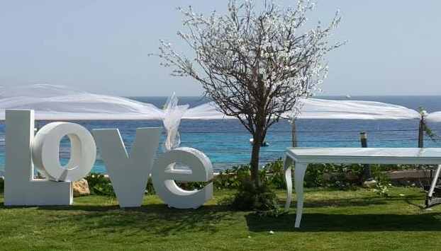

Slide 32
SERVICES & FACILITIES
Airport transfer service
24 hour duty manager
Bank and ATM service
Multilingual staff
Secretarial services
High speed Internet
Tour and travel desk
Daily laundry and valet service
Shopping arcade
PADI diving and water sports centre
24-hour room service
All major credit cards accepted
International Casino nearby
Doctor on call 24 hours a day
Car and limousine rental
Baby sitting service
Oasis Kids’ Club
Four floodlit Tennis Courts
Two air-conditioned squash courts
Recreation Facilities
Club Olympus: A complete indoor Fines center, aerobics studio, spa with massage and aromatherapy rooms, sauna, steam bath, whirlpool and plunge pool.
Diving center: Diving facilities are available upon request.
Aqua Fun: A three pool complex covering 2500 meters that includes an 83 meter corkscrew slide, lazy river, waterfalls, grottos and whirlpool.
Jogging track: 500 meters.
Water sports Center: A wide variety of water sports provide a comprehensive aqua experience, including diving, snorkeling, scuba and night diving.
Racquet Center: Including five tennis courts, two indoor, squash courts, one basketball court, beach volley ball, handball, table tennis and billiards.

Slide 33
Looking Forward to welcome you
Hyatt Regency Sharm El Sheikh
Gardens Bay, PO Box 58
Sharm El Sheikh, Soutth Sinai Egypt
T: +20 69 360 1234
E: sharm.regency@hyatt.com
sharmelsheikh.regency.hyatt.com

